Slide 1


Unit 4
Data collection process: At the facility
Notes:
Welcome to Unit 4 of Module 4.

Slide 2
By the end of this unit, you will be able to:
describe the CSPro data collection tasks at the health facility
explain who is responsible for each task in the process
Notes:
By the end of this unit, you will be able to:
describe the CSPro data collection tasks at the health facility;
explain who is responsible for each task in the process.

Slide 3
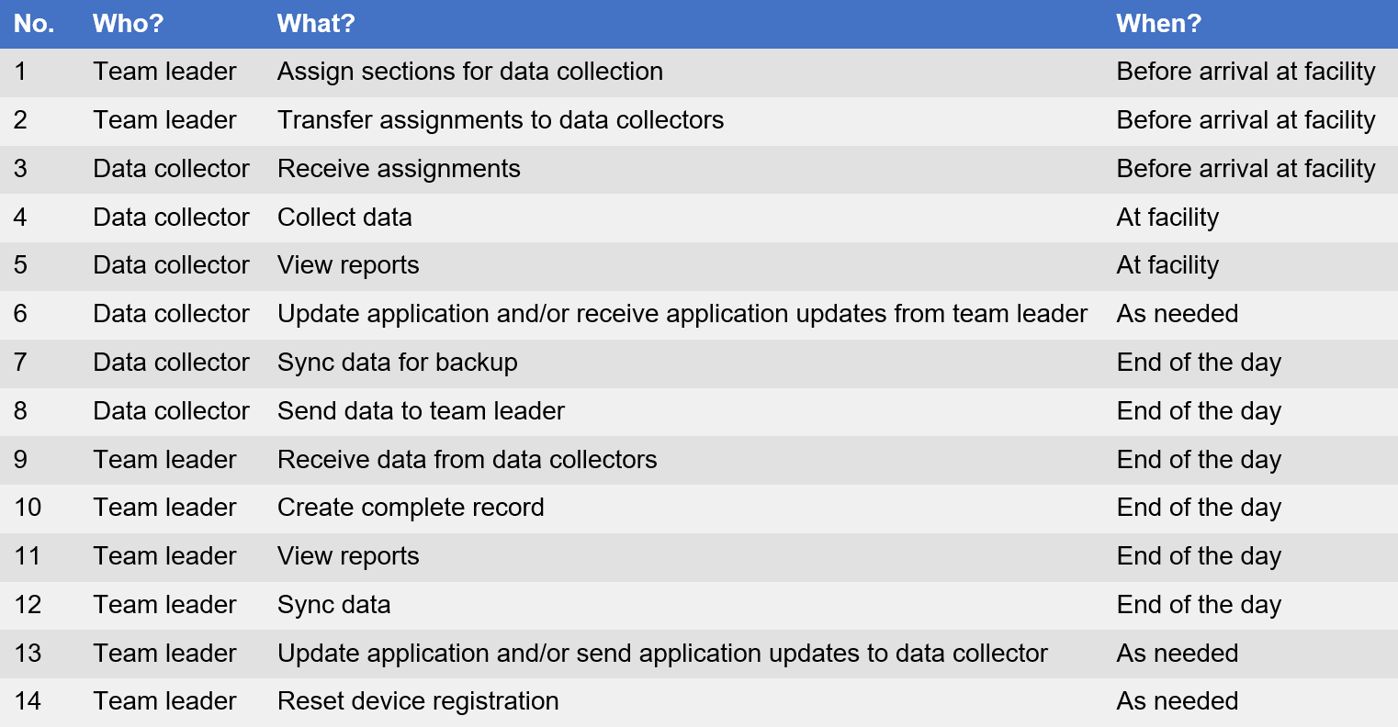
Process of data collection
Notes:
In this unit, we will explain the tasks that need to be carried out at the health facility, and the tasks that can be carried out as needed.

Slide 4
Data collector tasks at the facility
Notes:
Let’s start with the tasks that the data collector carries out at the health facility.

Slide 5
4. Collect data
Notes:
We will see how the data collector can collect data at the health facility.

Slide 6

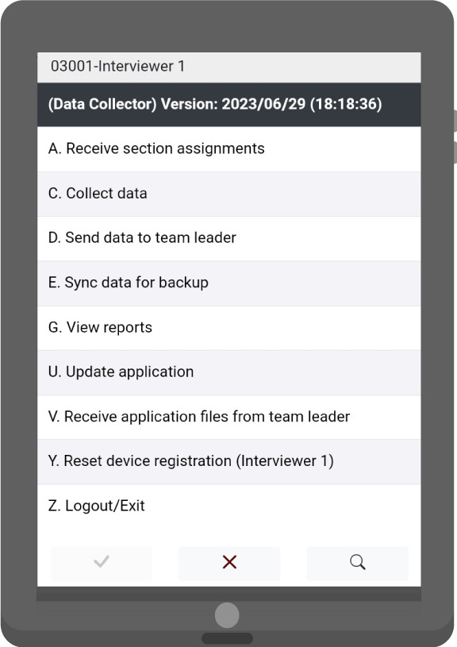
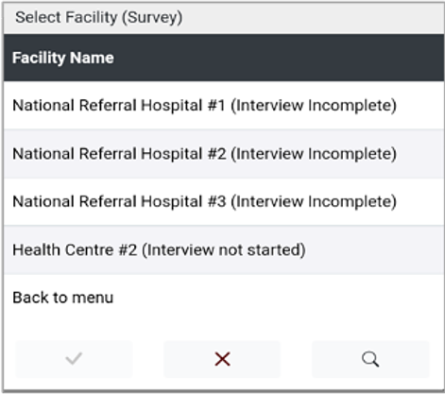
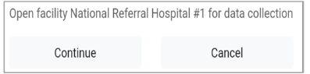
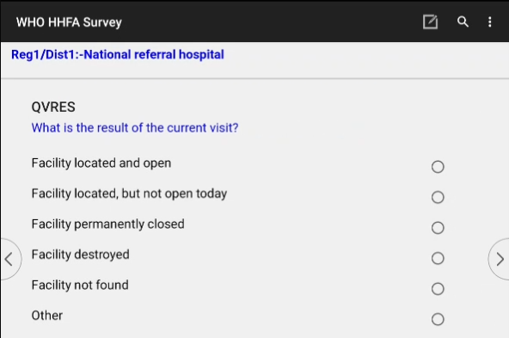
4. Collect data – facility status
Starting data collection
Select “Collect data”
List of facilities is displayed
Data collector confirms the facility selection
Select facility
Facility status window opens
Notes:
To start data collection, the data collector needs to select the “Collect data” option from the main menu.
A list of facilities for which the data collector has section assignments will display.
The data collector should select the appropriate facility.
Upon selection of a facility, the data collector is prompted to confirm the selection.
If they select Continue, a window to describe the status of the facility opens.

Slide 7
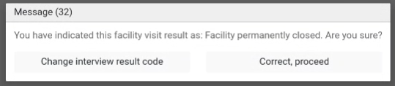
4. Collect data – facility status
Starting data collection
Data collector confirms this selection
Facility available for data collection
Facility not available for data collection
Notes:
If the data collector selects “Facility located and open”, the facility is available for data collection.
If they select:
“Facility located but not open today”;
“Facility permanently closed”;
“Facility destroyed”;
“Facility not found”; or
“Other”;
the facility is not available for data collection.
The data collector will be asked to confirm this selection and given the option to collect GPS coordinates before data entry closes.

Slide 8
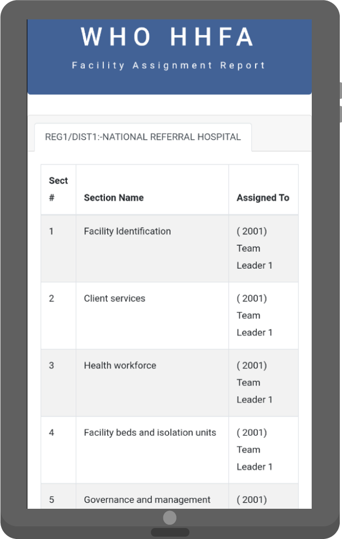
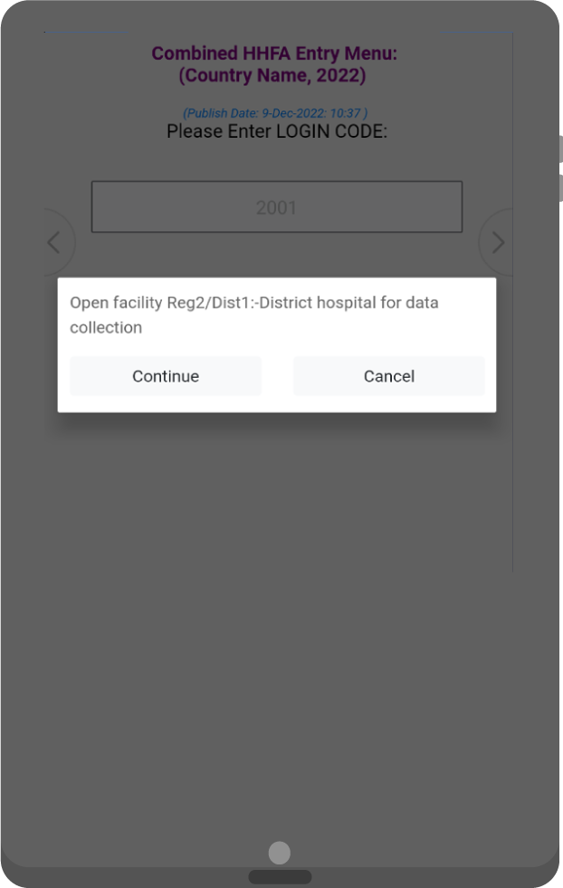
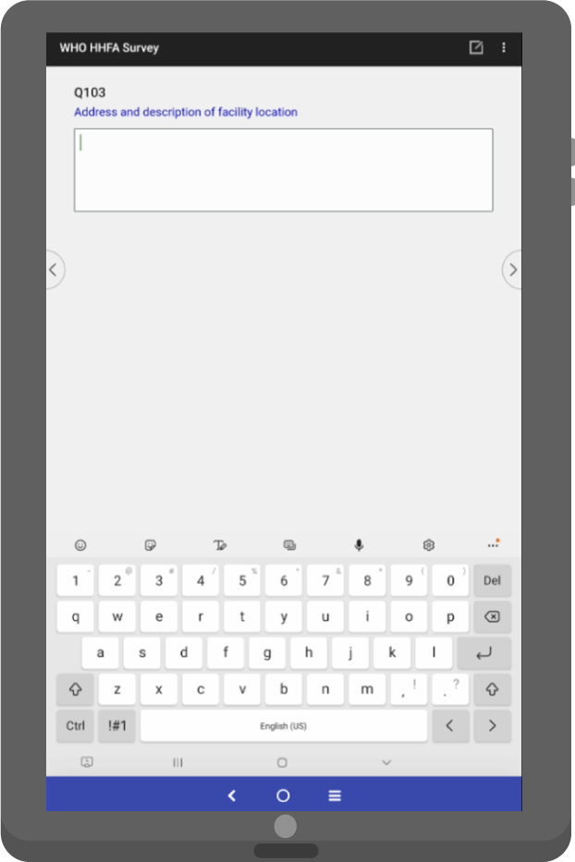
4. Collect data – facility identification
The data collector who is assigned the Facility identification section must complete that section before entering the flow control form.
Notes:
The data collector who is assigned the Facility identification section will be required to complete that section before entering the flow control form and having the option to complete other sections.

Slide 9
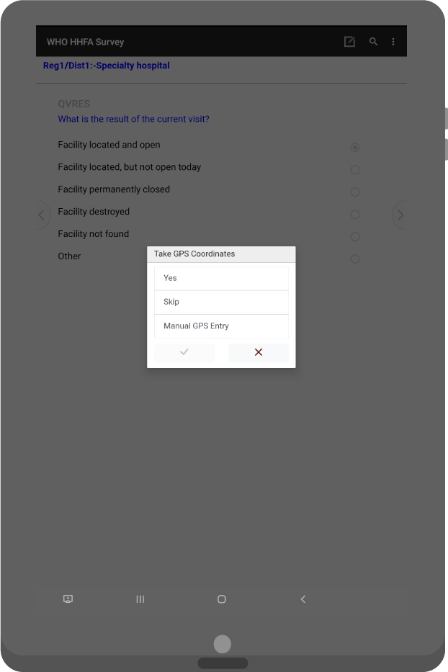
4. Collect data – GPS coordinates
The data collector assigned the Facility identification section will take the GPS coordinates.
outside the facility
clear view of the sky
Notes:
The data collector assigned the Facility identification section will take the GPS coordinates.
Before collecting the GPS coordinates, the data collector needs to make sure that they:
are located outside the facility;
with a clear view of the sky.
If the data collector selects “Yes”, the application will move to the flow control form after obtaining GPS coordinates.​
​ If the data collector selects “Skip”, the application will go back to the flow control form.

Slide 10
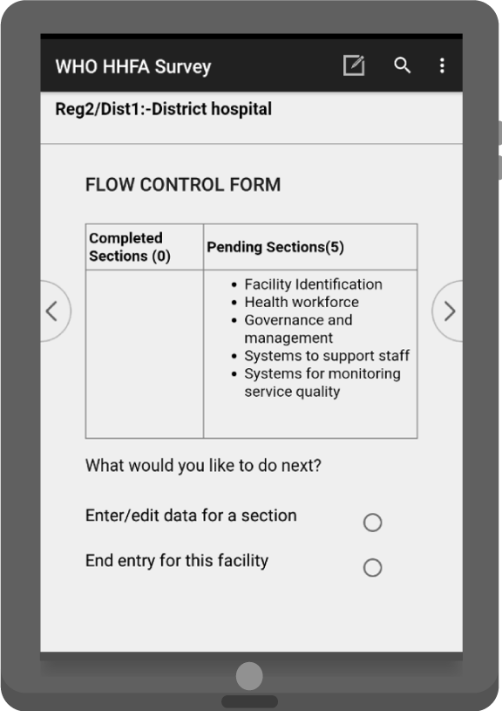
4. Collect data – flow control form
The flow control form allows data collectors to:
navigate into sections
keep track of the status of assigned sections
Notes:
The flow control form allows data collectors to:
navigate into sections; and
keep track of the status of the assigned sections.

Slide 11
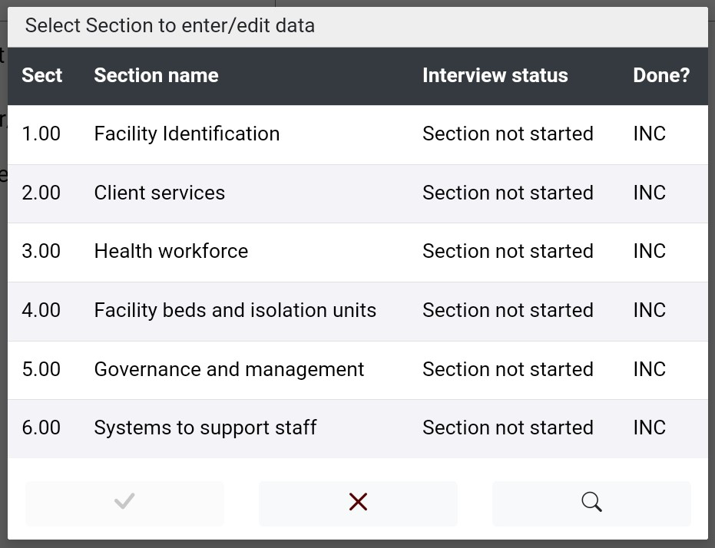
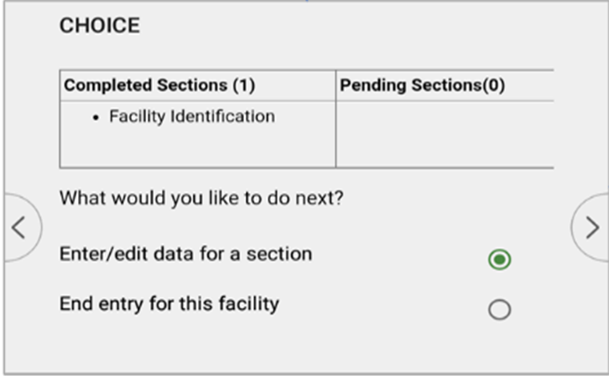
4. Collect data – flow control form
Enter/edit data for a section
Notes:
If the data collector selects “Enter/edit data for a section” in the flow control main form, they will be taken to the list of:
sections assigned to them;
the interview status (“Section not started”, “Section incomplete”, “Section complete”); and
a column indicating if the section is done.
Clicking the name of the section followed by the green check mark will allow data entry for a section.

Slide 12
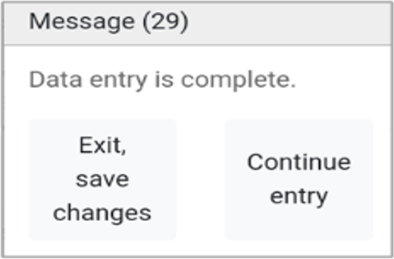
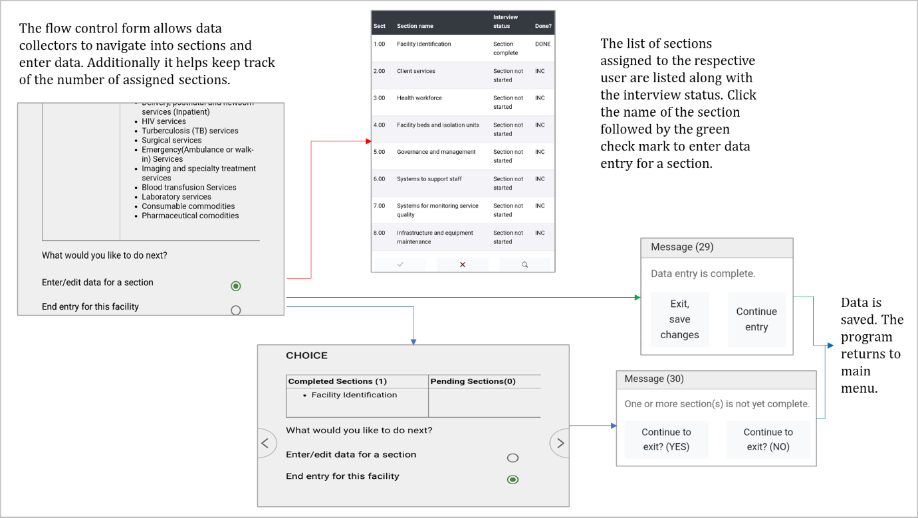
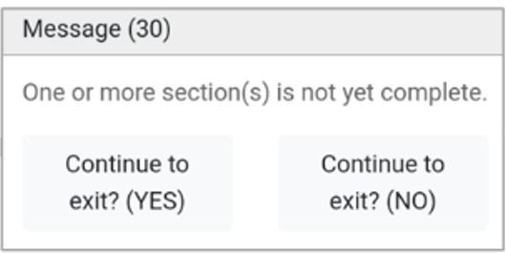
4. Collect data – flow control form
Completed data collection for a facility
Notes:
When the data collector completes data collection for a facility, they need to click “End entry” for this facility from the flow control main form.
if all the sections are complete, they will get a message saying “Data entry is complete”, with the options to exit, or continue entry, which is used in case the data collector still wants to make some changes in the data;
if one or more sections are incomplete, they will get a message saying “One or more sections are not yet complete”, with the options to continue or to exit;
for either of these options, the data are saved and the program returns to the main menu.

Slide 13
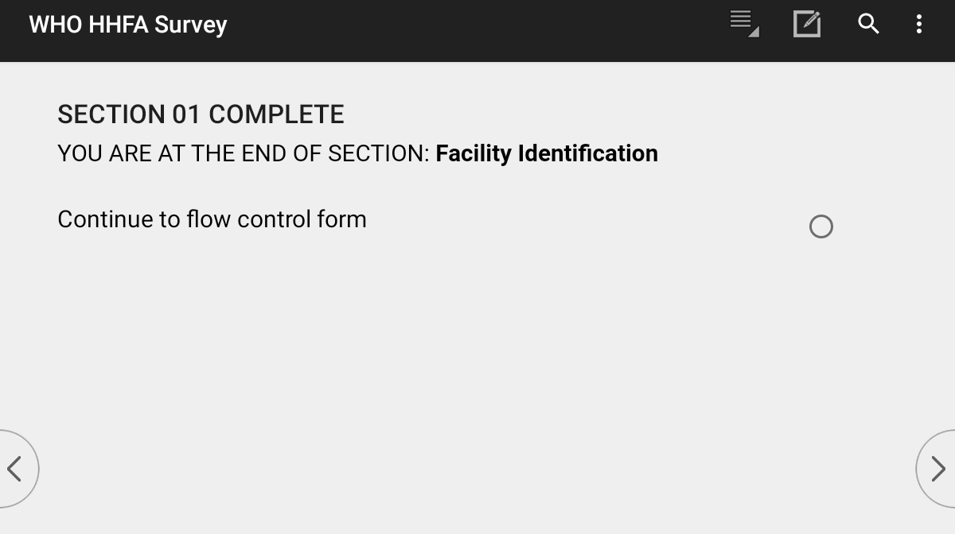
4. Collect data – entering section data
Entering data into a questionnaire section
questions are displayed sequentially
on completion of data entry, a message saying that the section is finished appears
data collector must go through all questions before landing on the section completion page
Notes:
After a section has been selected, the data collector needs to enter data for that questionnaire section.
The questions are displayed sequentially as they appear in the paper version of the questionnaire.
Upon completion of data entry for each section, a message informing the data collector that the section is finished appears.
The data collector MUST go through all questions before landing on the section completion page.

Slide 14
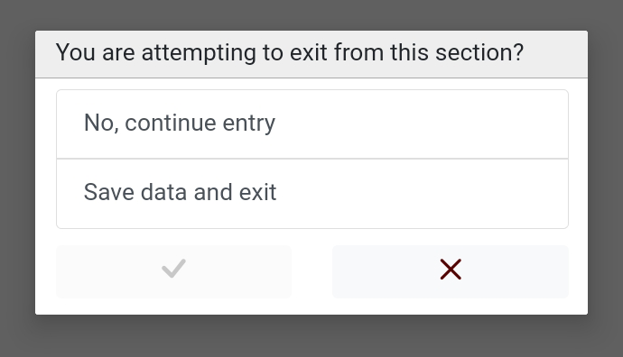
4. Collect data – editing section data
Partial saving of data during data entry
Pressing the Back button on the device saves the data entered.
continue data entry
save the data entered and exit
Notes:
During data entry in a section, if the data collector wants to save the data at any point, pressing the Back button on the device will save it.
A message should appear saying “Are you attempting to exit from this section”?
The data collector can:
continue data entry; or
save the data entered and exit, going to the flow control form.

Slide 15
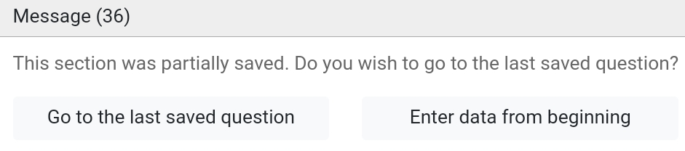
4. Collect data – editing section data
Resuming data entry
To resume data collection into a section partially saved, the application will prompt to:
resume from the last saved question
enter the data from the beginning
Notes:
If the data collector resumes data entry into a section partially saved, the application will prompt them to:
resume from the LAST saved question; or
enter the data from the beginning.

Slide 16
5. View reports
Notes:
The data collector can check where they are with data entry for their assigned sections by viewing reports, which is related to task 5.

Slide 17
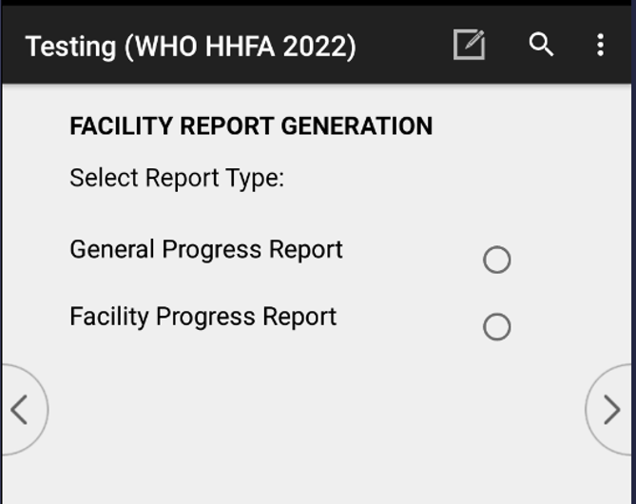
5. View reports
Generating reports
Select “View reports”
Select “Report Type”
Notes:
To generate a report, data collectors need to select the “View reports” option from the main menu and then select the report type.
There are 2 types of report that can be generated:
a General progress report; and
a Facility progress report.

Slide 18
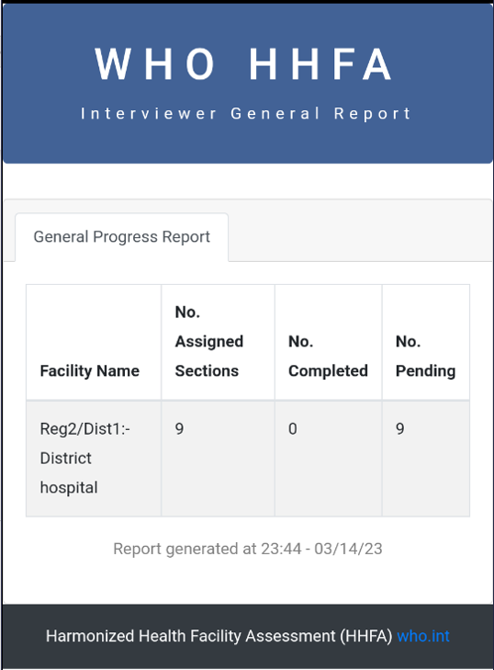
5. View reports
General progress report
number of sections assigned for each facility
number of completed and pending sections
Notes:
If General progress report is selected, the report will be displayed.
This report gives an overview of the number of sections assigned for each facility as well as the number of completed and pending sections.

Slide 19
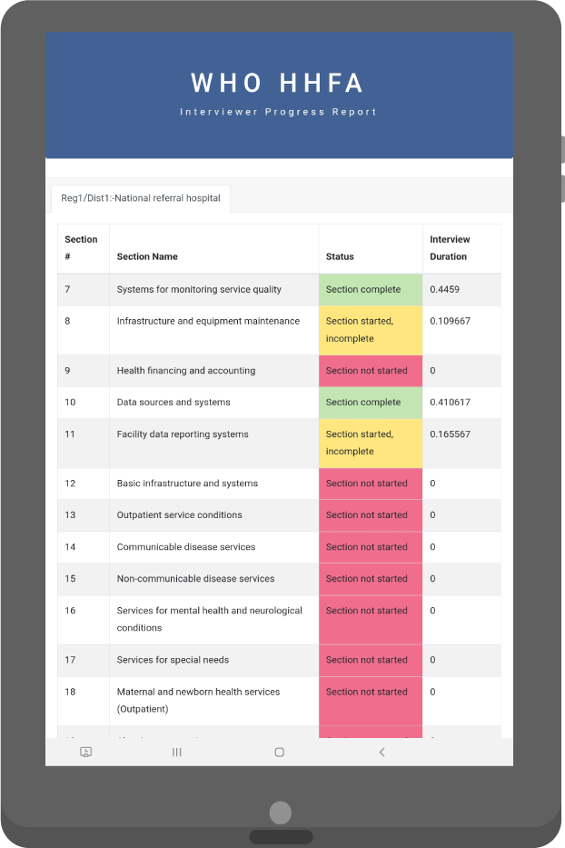
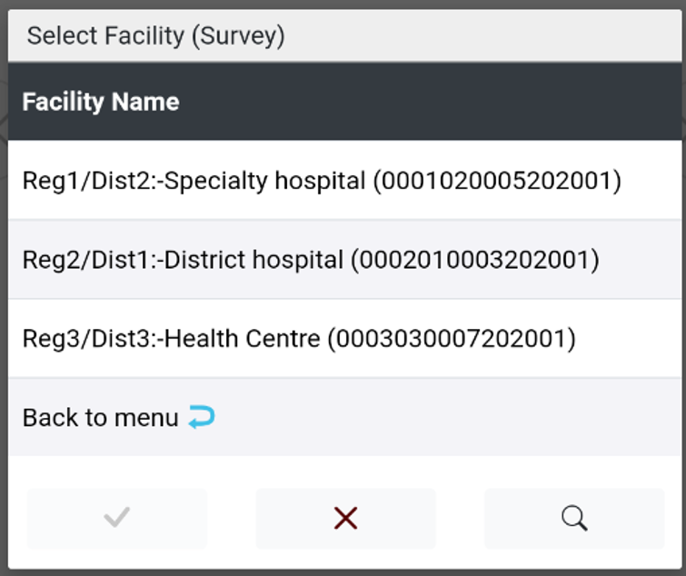
5. View reports
Facility progress report
Notes:
If Facility progress report is selected, the facility must then be selected before the report is displayed.
This report provides the status and interview duration of each of the assigned sections for a single facility.

Slide 20
Tasks to be carried out as needed
Notes:
We will now look at the tasks that can be carried out as needed.

Slide 21
DATA COLLECTOR: 6. Update application
TEAM LEADER: 13. Update application
Notes:
We will start with how to update the application in the devices.
This task should be carried out by both the data collector and the team leader as needed.

Slide 22

DATA COLLECTOR: 6. Update application
TEAM LEADER: 13. Update application
The HHFA application can be updated using:
the internet
Bluetooth
Notes:
The HHFA application can be updated using:
the internet; or
Bluetooth.

Slide 23
DATA COLLECTOR: 6. Update application via the internet
TEAM LEADER: 13. Update application via the internet
Updating via the internet:
requires active internet connection
pulls the latest version of the questionnaire from the server
Notes:
Updating the application via the internet:
requires an active internet connection; and
pulls the latest version of the questionnaire from the server.

Slide 24

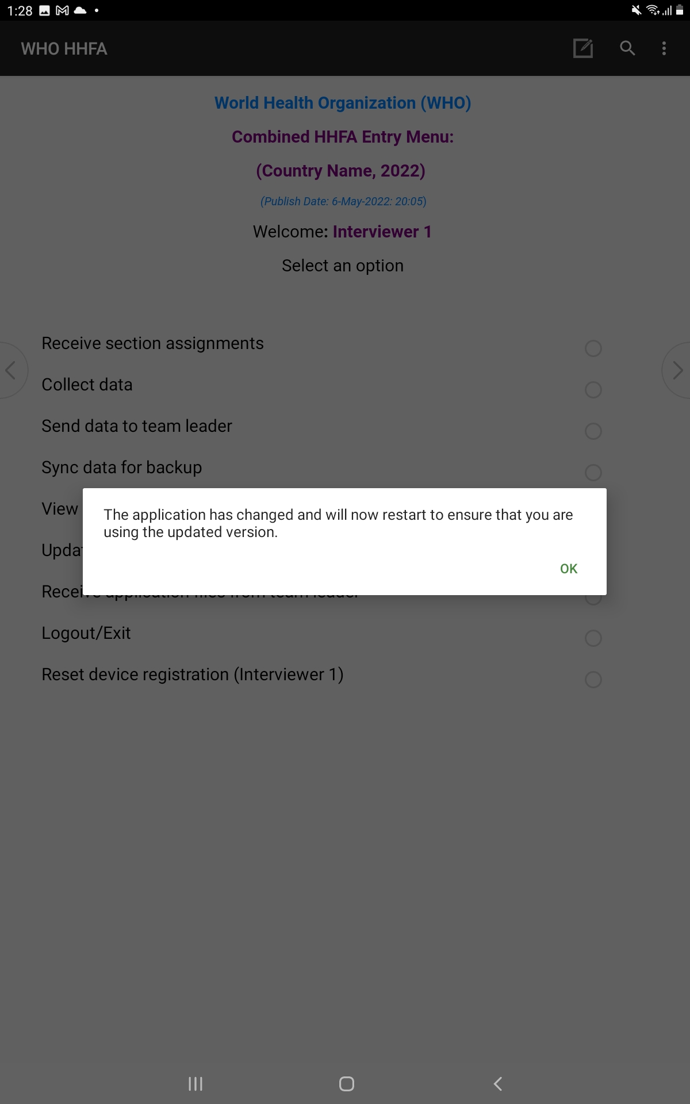
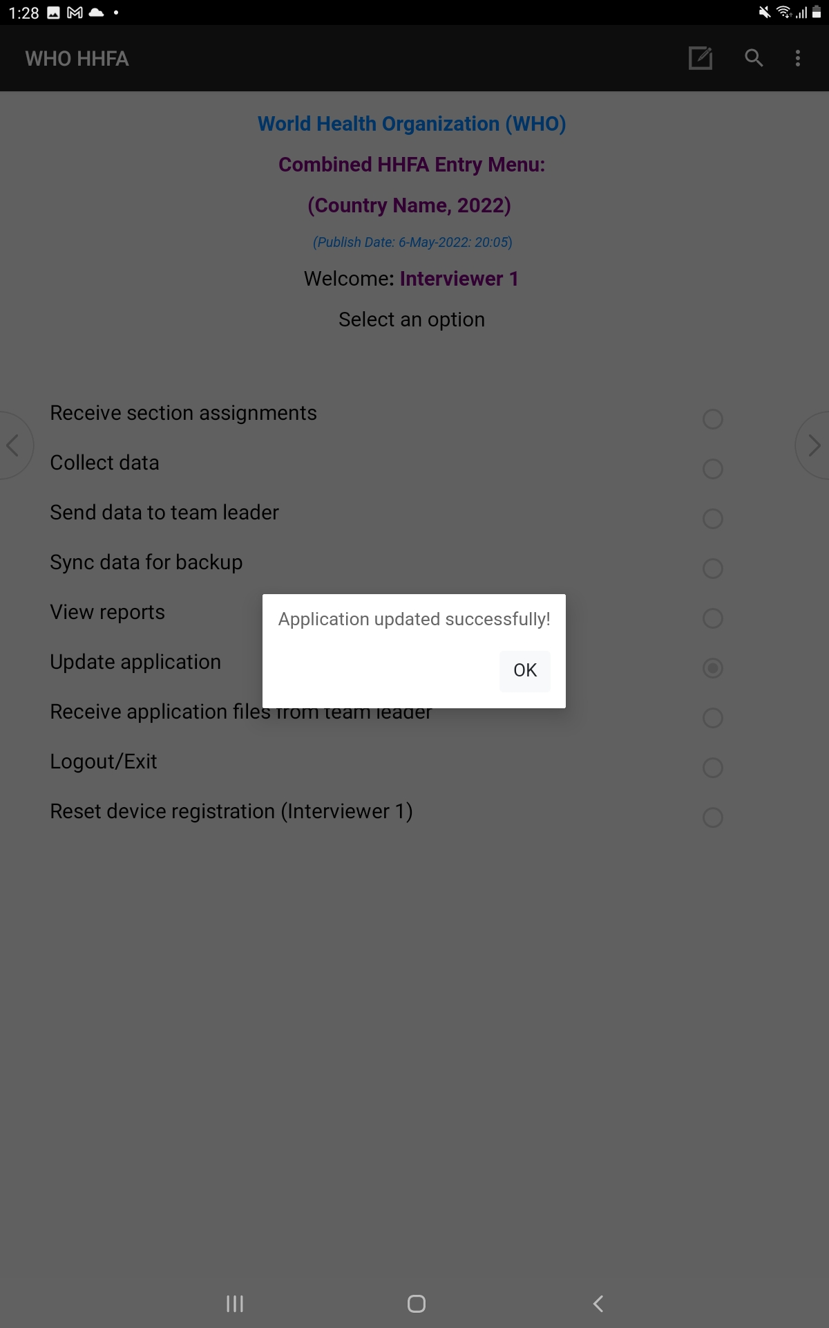
DATA COLLECTOR: 6. Update application via the internet
TEAM LEADER: 13. Update application via the internet
Data collectors and team leaders need to select the
“Update application” option from the main menu.
Notes:
Data collectors and team leaders need to select the “Update application” option from the main menu.
When the update is complete:
if no changes have been made, the message will say “Application updated successfully”;
if changes have been made:
the first message will say “The application has changed and will now restart to ensure that you are using the updated version”;
the second message will say “Application updated successfully”.
After the update, the application publish date changes to the version pulled from the server.

Slide 25
DATA COLLECTOR: 6. Update application via Bluetooth
TEAM LEADER: 13. Update application via Bluetooth
Bluetooth connection
manual transfer of application files
should only be used if there is no internet connection
Notes:
As with the transfer of the assigned sections of the questionnaire, application updates can also happen from team leaders to data collectors using a Bluetooth connection.
This is a manual transfer of application files from the team leader’s device to the data collector’s device.
This option should only be used if the data collector is not able to access an internet connection.

Slide 26

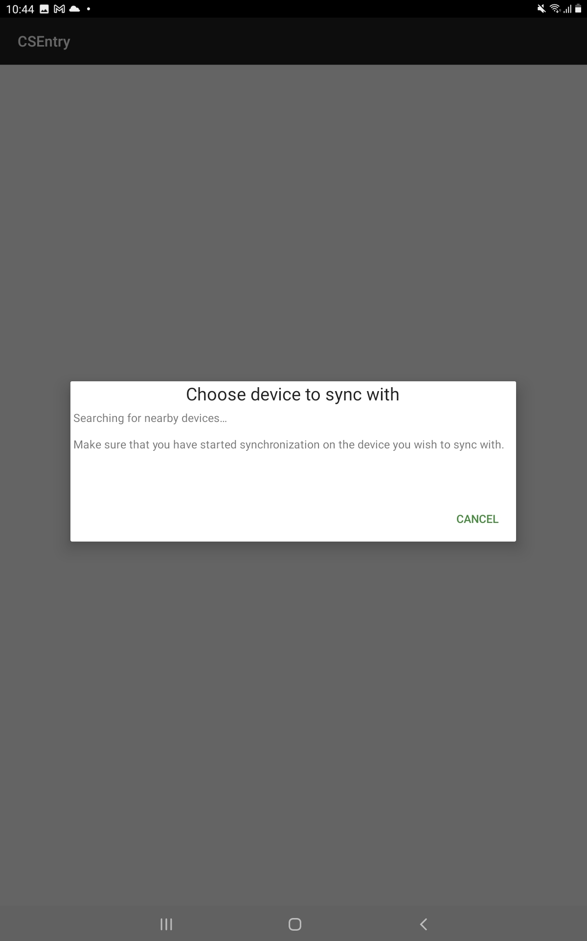

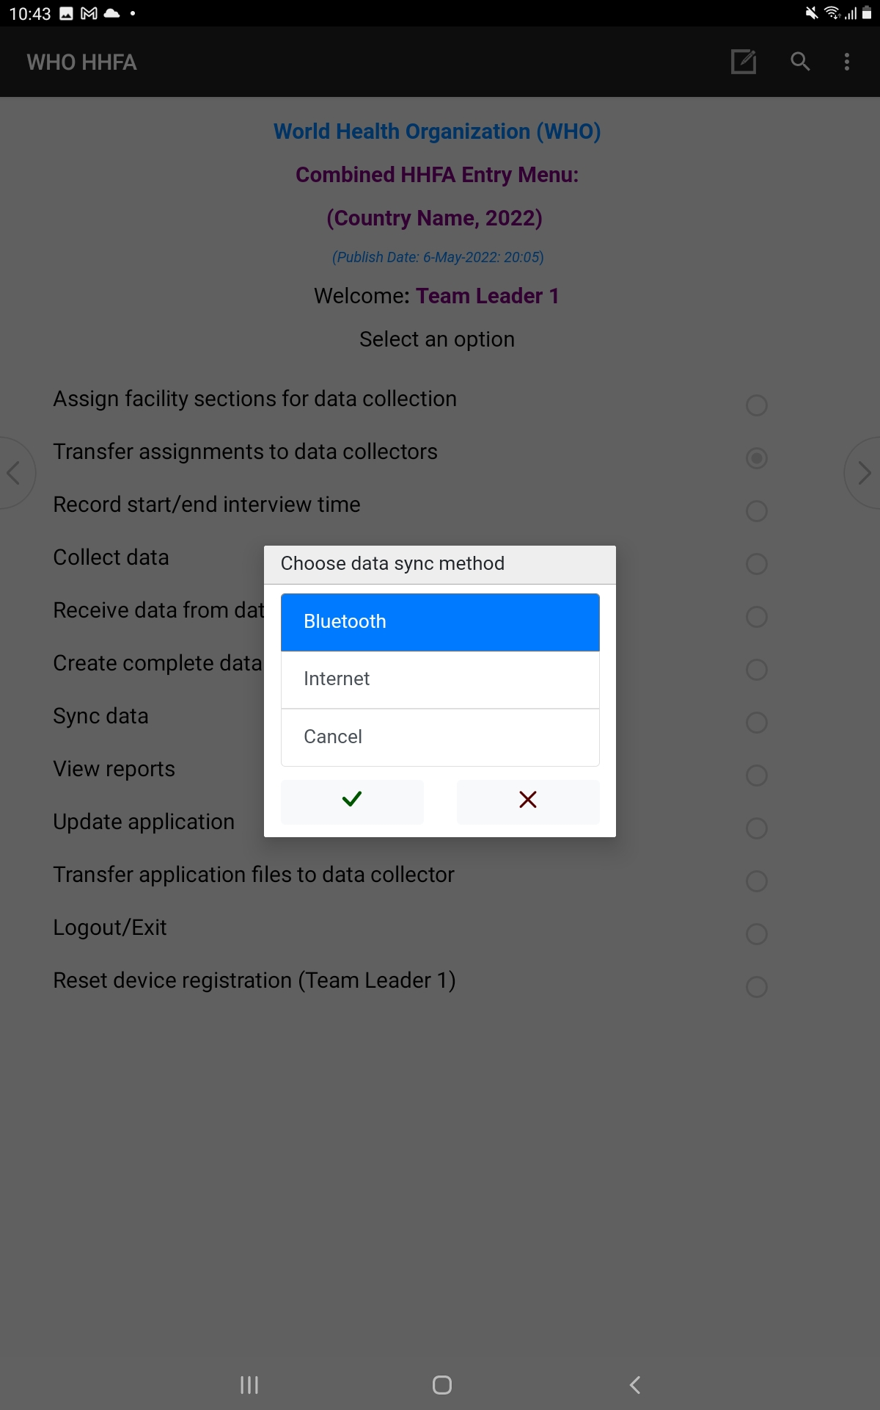

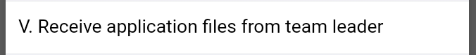
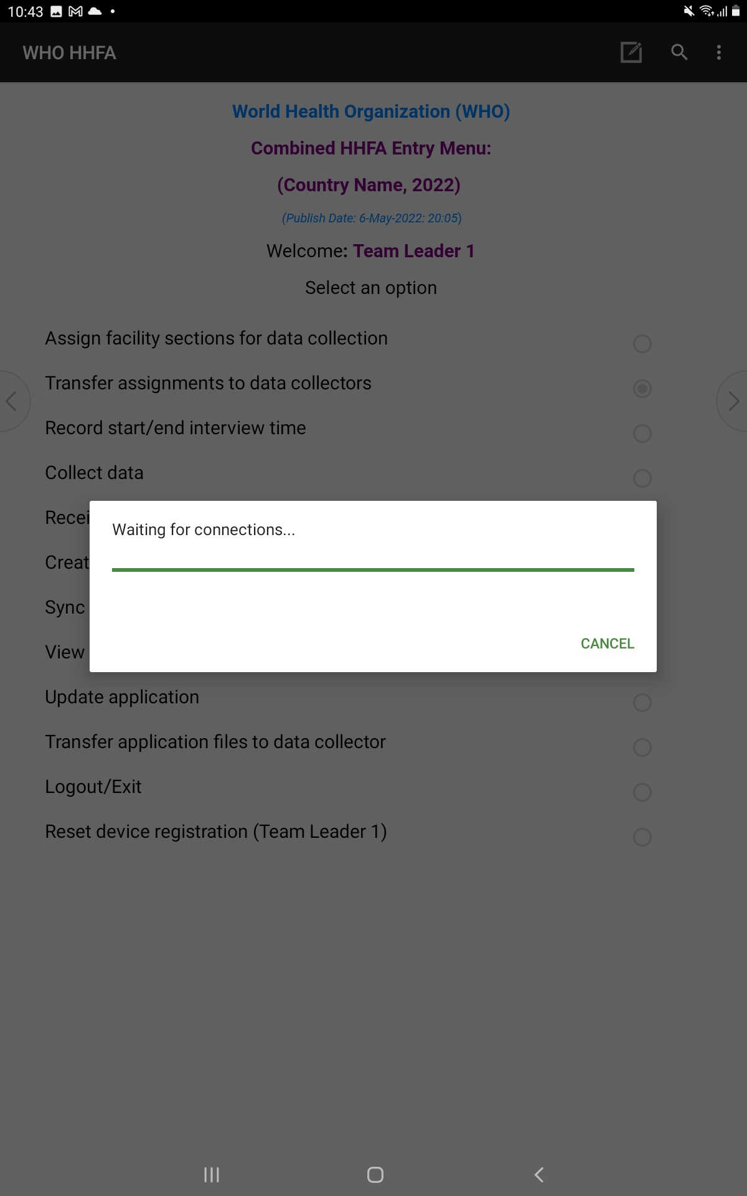
DATA COLLECTOR: 6. Update application via Bluetooth
TEAM LEADER: 13. Update application via Bluetooth
Data collector sends pairing request to team leader
Team leader
Data collector
Team leader waits for pairing request/accepts
Notes:
To update the application using Bluetooth:
the team leader selects “Transfer application files to data collectors”;
at the same time, the data collector selects “Receive application files from team leader”;
both the team leader and data collector select Bluetooth as the sync method;
the data collector chooses the team leader’s device from the list and sends a pairing request;
the team leader then waits for the pairing request from the data collector’s device and accepts it when it arrives to enable the devices to pair;
once the devices are paired and connected, the application files will be transferred from the team leader’s device to the data collector’s device.

Slide 27
14. Reset device registration
Notes:
We will finally see how to reset the device registration, one of the tasks that should be carried out by the team leader as needed.

Slide 28
14. Reset device registration
Device sharing is not permitted
Resetting the device registration:
Data collectors should not:
enables a registered device to be reset so that another data collector can log in
use their own device
can be used in a situation where the device should be used by another data collector
use a second device
share devices
team leaders can reset device registration for data collectors
must be done in-person
Notes:
Device sharing is not permitted! Data collectors should not:​
use their own device​;
use a second device; or​
share devices​.
​
Resetting the device registration enables a registered device to be reset so that another data collector can login. ​
The feature can be used in a situation where the device should be used by another data collector.​
Team leaders can reset the device registration for data collectors on their team. ​
Resetting device registration must be done in-person and cannot be done remotely.

Slide 29
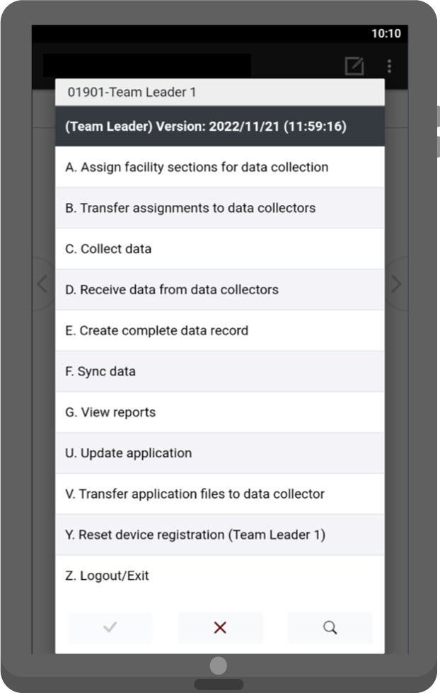
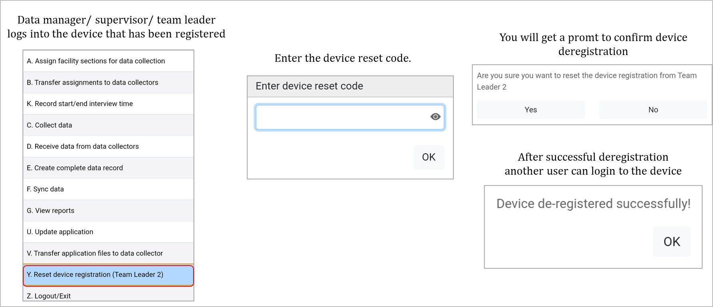
14. Reset device registration
To reset a device’s registration:
1. Team leader/
supervisor/data manager logs into device
3. A message will appear
asking for confirmation of device deregistration
2. User enters the device
reset code
4. A message will appear informing that the device
has been deregistered
Notes:
To reset a device’s registration:​
the respective team leader/supervisor/data manager logs into the device that has been registered using the code that the device was originally registered to;
the user enters the device reset code;​
a message will appear asking for confirmation of the device deregistration. Select “Yes” to proceed;
a message will appear informing that the device has been successfully deregistered. At this point, the next user that logs into the device will be required to register the device before they can use it to collect HHFA data.

Slide 30
You have now completed Unit 4.
In the next unit, we will look at the data collection process at the end of the day.
Notes:
You have now completed Unit 4.
In the next unit, we will look at the data collection process at the end of the day.

